Slide 1


Slide 2




Object Oriented Design and Programming (01AI0403)
Unit – 3
Functions

Slide 3


OUTLINE
Functions – Introduction
Call and Return by reference
Default arguments
Overloaded function
Macro Vs. Inline functions
Friend functions

Slide 4
Functions – Introduction
A function is said to be a set of instructions that can perform a specific task.
It will reduce the size of the program by calling and using them at different places in the program.
The advantages are: Reusability, modularity, overall programming simplicity.
Functions are classified into 2 categories,
Library functions
User-defined functions

Slide 5
Library Functions
The functions that are already available in the C++ library are called Library functions.
Some important categories of library functions are :
Input/Output functions (iostream.h),
Mathematical functions (math.h),
String handling functions (string.h),
Console input/output functions (conio.h) and
Manipulator functions (iomanip.h).

Slide 6
User-Defined Functions
A function defined by the user is called as user-defined function. C++ allows the programmer to define their own function.
A user-defined function groups code to perform a specific task and that group of code is given a name (identifier).
When the function is invoked or call from any part of the program, it all executes the codes defined in the body of the function.
The advantage of user-defined function is that the complexity of a program is reduced and the errors can be traced easily.

Slide 7
Main Function
Every C/C++ program has at least one function that the name is main. The main function is called by the operating system by which our code is executed.
The main() returns a value of type int to the operating system. We can make n number of function in a single program but we can make only one main function in a single program. Every program has only one main function.
int main( )
The function that have a return value should use the return statement for termination.

Slide 8
Main Function
The main( ) function in C++, defined as follows:
int main( )
{
---------
---------
return 0;
}
The return type of function is int by default, the keyword int in the main( ) header is optional.
Most C++ compilers will generate an error or warning if there is no return statement.

Slide 9
Function Declaration
Function Prototyping (or declaration):
The prototype describes the function interface to the compiler by giving details such as the number and type of arguments and the type of return values.
When a function is called, the compiler uses the template to ensure that proper arguments are passed, and the return value is treated correctly.

Slide 10
Functions
Syntax:
Function prototype is a declaration statement in the calling program and is of the following form:
return type function-name( argument-list );
The argument-list contains the types and names of arguments that must be passed to the function.
Example:
int cal(int, int, float);
float sum(int a, float b, float c);

Slide 11
Function Definition
Function definition defines the operations of a function which is already declared.
When the function definition comes before the main() function, we need not declare it.
Syntax:
returntype function-name(parameter list)
{
//body of statements
}
Example:
float sum(int a, float b, float c)
{
float v=a+b+c;
----------
}

Slide 12
Function Call
The process of calling a function for execution is known as function call.
Any user defined function can call any other function. There are two types of function call,
Call by value
Call by Reference

Slide 13
Function call
The function sum( ) can be invoked in a program as follows:
float addval = sum(b1,w1,h1); //function call
The variable b1,w1 and h1 are known as the actual parameters (arguments) which specify the dimensions of addval.
Their types should match with the types declared in the prototype.
The calling statement should not include type names in the argument list.

Slide 14
Functions types
Different types of Functions based arguments
Function with parameters (arguments) and without return values.
Function with parameters (arguments) and with a return value.
Function without parameter (argument) and with a return value.
Function without parameter (argument) and without a return value.

Slide 15

Function with parameters (arguments) and without return values
#include<iostream>
using namespace std;
int add(int x, int y)
{
cout<< "Adding a and b is:"<<x+y;
}
int main( )
{
int a=10, b=10;
add(a,b);
}

Slide 16

Function with parameters (arguments) and with a return value
#include<iostream>
using namespace std;
int add(int x, int y)
{
return(x+y);
}
int main( )
{
int a=10, b=10;
cout <<"Result:"<<add(a,b);
}

Slide 17

Function without parameter (argument) and with a return value
#include <iostream>
using namespace std;
int add()
{
int x=10, y=10;
return(x+y);
}
int main( )
{
cout <<"Add a and b:"<< add();
}

Slide 18

Function without parameter (argument) and without a return value
#include <iostream>
using namespace std;
int add()
{
int x=10, y=10;
cout <<" Adding x and y value is:"<< (x+y);
}
int main( )
{
add();
}

Slide 19
Call by value
The call by value method of passing arguments to a function copies the actual value of an argument into the formal parameter of the function.
The changes made to the parameter inside the function have no effect on the argument.
By default, C++ uses call by value to pass arguments means that code within a function cannot alter the arguments used to call the function.

Slide 20
Call by value – Example
#include <iostream>
using namespace std;
void swap(int x, int y); // function declaration
int main ()
{
int a = 100, b= 200; // local variable declaration
cout << "Before swap, value of a :" << a << endl;
cout << "Before swap, value of b :" << b << endl;
swap(a, b); // Call by value
cout << "After swap, value of a :" << a << endl;
cout << "After swap, value of b :" << b << endl;
return 0;
}
void swap(int x, int y)
{
int temp;
temp=x;
x=y;
y=temp;
}
Output:
Before swap, value of a :100
Before swap, value of b :200
After swap, value of a :100
After swap, value of b :200

Slide 21
Call by Reference
In C++, it permits us to pass parameters to the function by reference based on actual / formal arguments.
Actual Arguments
The arguments listed or defined in the function calling statement that is called Actual Arguments.
Formal Arguments
The arguments used in the function declaration that is called Formal Arguments.

Slide 22
Call by Reference
The call by reference method of passing arguments to a function copies the reference of an argument into the formal parameter.
Inside the function, the reference is used to access the actual argument used in the call.
This means that changes made to the parameter affect the passed argument.
To pass the value by reference, argument reference is passed to the functions just like any other value.

Slide 23
Call by Reference – Example
#include <iostream>
using namespace std;
// function declaration
void swap(int &x, int &y);
int main ()
{
// local variable declaration:
int a = 100;
int b = 200;
cout << "Before swap, value of a :" << a << endl;
cout << "Before swap, value of b :" << b << endl;
swap(a, b);
cout << "After swap, value of a :" << a << endl;
cout << "After swap, value of b :" << b << endl;
return 0;
}
void swap(int &x, int &y)
{
int temp;
temp = x;
x = y;
y = temp;
return;
}
Output:
Before swap, value of a :100
Before swap, value of b :200
After swap, value of a :200
After swap, value of b :100

Slide 24
Function Overloading
Function overloading: Where two or more functions can have the same name but differ in the type or number of their parameters. This allows you to create functions that can handle different types of input with the same function name.
Function overloading is a compile-time polymorphism.
The function overloading in the C++ feature is used to improve the readability of the code. It is used so that the programmer does not have to remember various function names.
If any class has multiple functions with different parameters having the same name, they are said to be overloaded.
If we have to perform a single operation with different numbers or types of arguments, we need to overload the function.

Slide 25
Function Overloading
C++ has many features, and one of the most important features is function overloading.
Conditions of overloading:
The easiest way to remember this rule is that the parameters should qualify any one or more than one of the following conditions:
They should have a different type
They should have a different number
They should have a different sequence of parameters.

Slide 26
Function Overloading: Example 1
#include <iostream>
using namespace std;
void print(int i) {
cout << "Here is int: " << i << endl;
}
void print(double f) {
cout << "Here is float: " << f << endl;
}
void print(string s) {
cout << "Here is string: " << s << endl;
}
int main() {
print(10);
print(10.5);
print("Hello");
return 0;
}

Slide 27
Function Overloading – Example 2
#include <iostream>
using namespace std;
void Sum(int A, int B);
void Sum(int A, int B, int C);
void Sum(int A, int B, int C, int D);
int main()
{
Sum(1,2);
Sum(1,2,3);
Sum(1,2,3,4);
return 0;
}
void Sum(int A, int B)
{
cout<< endl << "SUM is : "<< A+B;
}
void Sum(int A, int B, int C)
{
cout<< endl << "SUM is : "<< A+B+C;
}
void Sum(int A, int B, int C, int D)
{
cout<< endl << "SUM is : "<< A+B+C+D;
}
Output:
Sum is 3
Sum is 6
Sum is 10

Slide 28
Function Overloading – Example 3
#include <iostream>
using namespace std;
class Addition
{
public:
int sum(int a,int b)
{
return a+b;
}
int sum(int a,int b, int c)
{
return a+b+c;
}
};
int main(void)
{
Addition obj; //creating object
cout<<obj.sum(20, 15)<<endl;
cout<<obj.sum(81, 100, 10)<<endl;
return 0;
}
Output:
35
191

Slide 29
Inline Functions
An inline function in C++ is a function that is expanded in line when it is called. This means that instead of performing a regular function call, the compiler replaces the function call with the function code itself. This can improve performance by avoiding the overhead of a function call, especially for small, frequently-called functions.
C++ provides inline functions to reduce the function call overhead. An inline function is a function that is expanded in line when it is called.
When the inline function is called whole code of the inline function gets inserted or substituted at the point of the inline function call.

Slide 30
Inline Functions
This substitution is performed by the C++ compiler at compile time. An inline function may increase efficiency if it is small.
When it comes to enhancing the performance of the program, the inline function proves to be an excellent concept.
Inline function in C++ is an enhancement feature that improves the execution time and speed of the program.
The main advantage of inline functions is that you can use them with C++ classes as well.

Slide 31
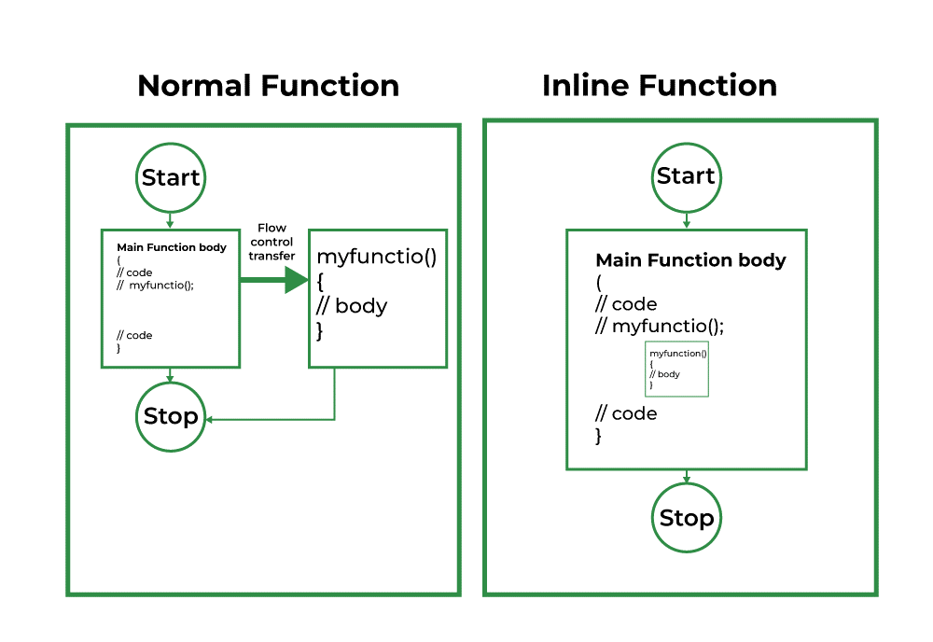
Inline Functions

Slide 32
Inline Functions
The compiler may not perform inline in such circumstances as:
If a function contains a loop. (for, while and do-while)
If a function contains static variables.
If a function is recursive.
If a function return type is other than void, and the return statement doesn’t exist in a function body.
If a function contains a switch or goto statement.

Slide 33
Inline Functions
Syntax:
inline return-type function-name(parameters)
{
// function code
}

Slide 34
Inline Function – Example 1
#include <iostream>
using namespace std;
inline int cube(int s)
{
return s * s * s;
}
int main()
{
cout << "The cube of 3 is: " << cube(3) << "\n";
return 0;
}
Output:
The cube of 3 is: 27

Slide 35
Inline Function – Example 2
#include <iostream>
using namespace std;
inline int add(int a, int b) {
return a + b;
}
int main() {
cout << "Sum: " << add(5, 3) << endl; // Inline function call
return 0;
}

Slide 36
Macro Functions
A macro is defined as the piece of code that is replaced by the value of the macro in the program.
Whenever a compiler encounters the macro name, it replaces it with the definition of the macro.
Macros are initialized with the #define pre-processor command and can be undefined with the #undef command.
There is no need to terminate the macro definition using a semi-colon (;)

Slide 37
Macro Functions
#include <iostream>
using namespace std;
#define Area 10
int main()
{
// Print the value of macro defined
cout << "The value of AREA is :" << Area;
return 0;
}
Output:
The value of AREA is :10
Notes:
#define PI 3.14

Slide 38
Macro Functions
There are two types of macros:
Object-like macros
Function-like macros
1. Object-Like Macros
These macros are replaced by their value in the source code before compilation. Their primary purpose is to define constants to be used in the code

Slide 39
Macro Functions
Example
#include <iostream>
using namespace std;
#define PI 3.1416
int main()
{
float radius = 3;
float area;
area = PI * radius * radius;
cout << "Area is " << area;
return 0;
}
Output:
Area is 28.2744

Slide 40
Macro Functions
2. Function-Like Macros
These macros behave like functions, in that they take arguments that are used in the replaced code.
When defining a function-like macro, there cannot be a space between the macro name and the opening parenthesis.

Slide 41
Macro Functions
#include <iostream>
using namespace std;
#define PI 3.1416
#define AREA(r) r * r * PI
int main()
{
float radius = 5;
float result;
result = AREA(radius);
cout << "Area is " << result;
return 0;
}
Output:
Area is 78.54

Slide 42
Macro Functions
Predefined Macros
C++ has a number of predefined macros, including the following:
__DATE__: Current date formatted as MMM DD YYYY.
__TIME__: Current time formatted as HH:MM:SS.
__FILE__: Current filename.
__LINE__: Current line number.

Slide 43
Macro Functions
Example - predefined macros
#include <iostream>
using namespace std;
int main()
{
char file[] = __FILE__;
char date[] = __DATE__;
char time[] = __TIME__;
int line = __LINE__;
cout << "File name: " << file << "\n";
cout << "Date: " << date << "\n";
cout << "Time: " << time << "\n";
cout << "Line number: " << line << "\n";
}
Output:
File name: main.cpp
Date: Jun 25 2022
Time: 14:17:50
Line number: 9

Slide 44
Macro Functions
Undefining a Macro
Once defined, a macro can be undefined with the #undef command.
Using the macro after that point will result in a compile error.

Slide 45

Macro Functions
Example – Undefining a Macro
#include <iostream>
using namespace std;
#define MAX_SIZE 100
int main() {
cout << "The value of MAX_SIZE: " << MAX_SIZE
<< endl;
#undef MAX_SIZE
#ifdef MAX_SIZE
cout << "MAX_SIZE is defined." << endl;
#else
cout << "MAX_SIZE is not defined." << endl;
#endif
return 0;
}
Output:
The value of MAX_SIZE: 100 MAX_SIZE is not defined.

Slide 46
Friend Function
Friend functions of the class are granted permission to access private and protected members of the class in C++.
They are defined globally outside the class scope. Friend functions are not member functions of the class.
A friend function can access the private and protected data of a class. We declare a friend function using the friend keyword inside the body of the class.

Slide 47
Friend Function
The friend function is declared using the friend keyword inside the body of the class.
Syntax:
class className
{
... .. ...
friend returnType functionName(arguments);
... .. ...
}

Slide 48
Special Characteristics of Friend Function
It is not in the scope of the class to which it has been declared friend.
Since it is not in the scope of the class, it can not be called using object of that class.
It can be invoked or call like a normal without the help of any object.
Unlike the normal function, it can not access the members name directly and has to use an object name and (.) dot membership operator with each member name.
It can be declared either in the public or the private part of a class without affecting its meaning.
Usually, it has the objects as arguments.

Slide 49
Friend Function – Example
#include <iostream>
using namespace std;
class sample
{
int a,b;
public:
void setvalue()
{
a = 25;
b= 40;
} //func decleration
friend float mean(sample s);
};
float mean(sample s) //func definition
{
return float(s.a + s.b)/2.0;
}
int main()
{
sample X; //objectX
X.setvalue();
cout<< "Mean value = " << mean(X) <<endl;
return 0;
}
Output:
Mean value = 32.5

Slide 50
Default Argument Function
A default argument is a value provided in a function declaration that is automatically assigned by the compiler if the calling function doesn’t provide a value for the argument.
Assigning some default values to the argument is the default argument function and the benefit of a default argument is we can combine the overloaded function and write one single function.
This is a very powerful feature of C++ and it is friendly for the programmer.

Slide 51
Default Argument Function
Default arguments are different from constant arguments as constant arguments can’t be changed whereas default arguments can be overwritten if required.
Default arguments are overwritten when the calling function provides values for them.
When a function is called, the arguments are copied from the calling function to the called function in the order left to right.
Once a default value is used for an argument in the function definition, all subsequent arguments to it must have a default value as well. It can also be stated that the default arguments are assigned from right to left

Slide 52
Default Argument Function
#include <iostream>
using namespace std;
int Sum(int x, int y, int z = 0)
{
return x + y + z;
}
int Max(int a = 0, int b = 0, int c = 0)
{
return a > b && a > c ? a : (b > c ? b : c);
}
int main()
{
cout <<"Sum of 3 numbers:"<< Sum(10, 20, 3) << endl;
cout <<"Sum of 2 numbers:"<< Sum(10, 20) << endl;
cout <<"Max of 3 numbers:"<< Max(13, 22, 45) << endl;
cout <<"Max of 2 numbers:"<< Max(22, 53) << endl;
return 0;
}
Output:
Sum of 3 numbers:33
Sum of 2 numbers:30
Max of 3 numbers:45
Max of 2 numbers:53

Slide 53
Default Argument Function
Advantages of Default Arguments:
Default arguments are useful when we want to increase the capabilities of an existing function as we can do it just by adding another default argument to the function.
It helps in reducing the size of a program.
It provides a simple and effective programming approach.
Default arguments improve the readability of a program.
Disadvantages of Default Arguments:
It increases the execution time as the compiler needs to replace the omitted arguments by their default values in the function call.

Slide 54


